Slide 1
Focus Days 2014
Innovative Hausrat Inventar App
UX Design
22.5.2014
Lorenz Hänggi

Slide 2
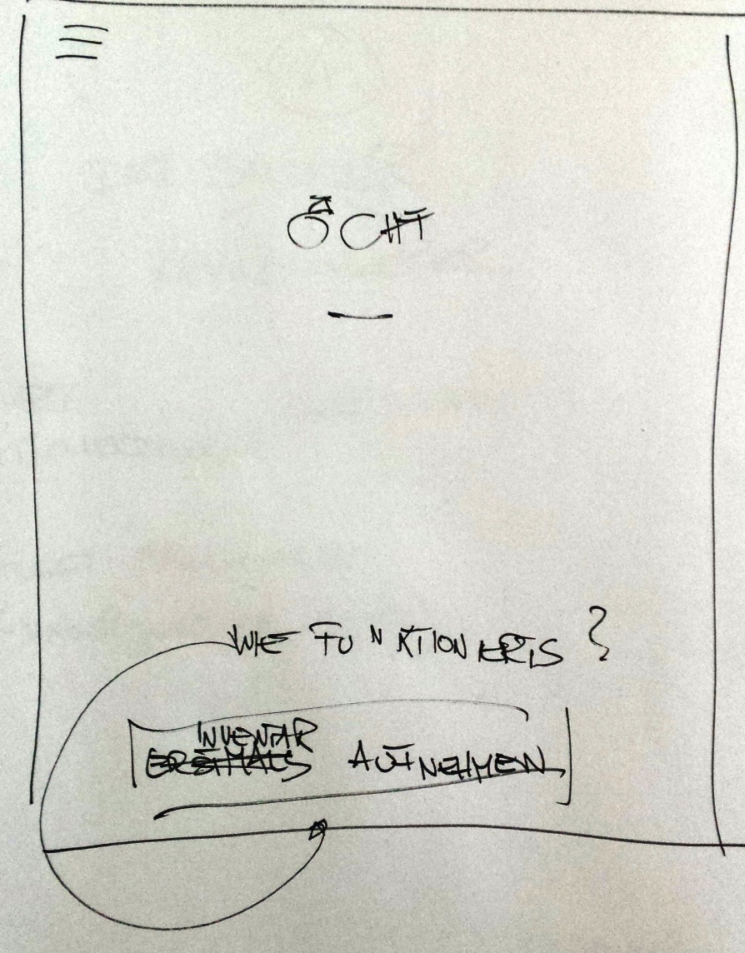
01-Home – 1.mal

Slide 3
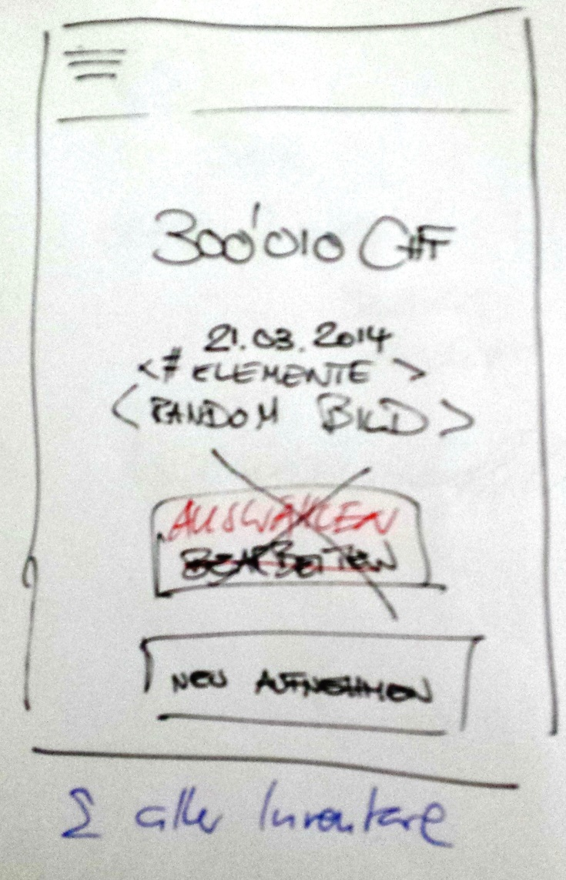
01-Home – 2.-N.Mal

Slide 4
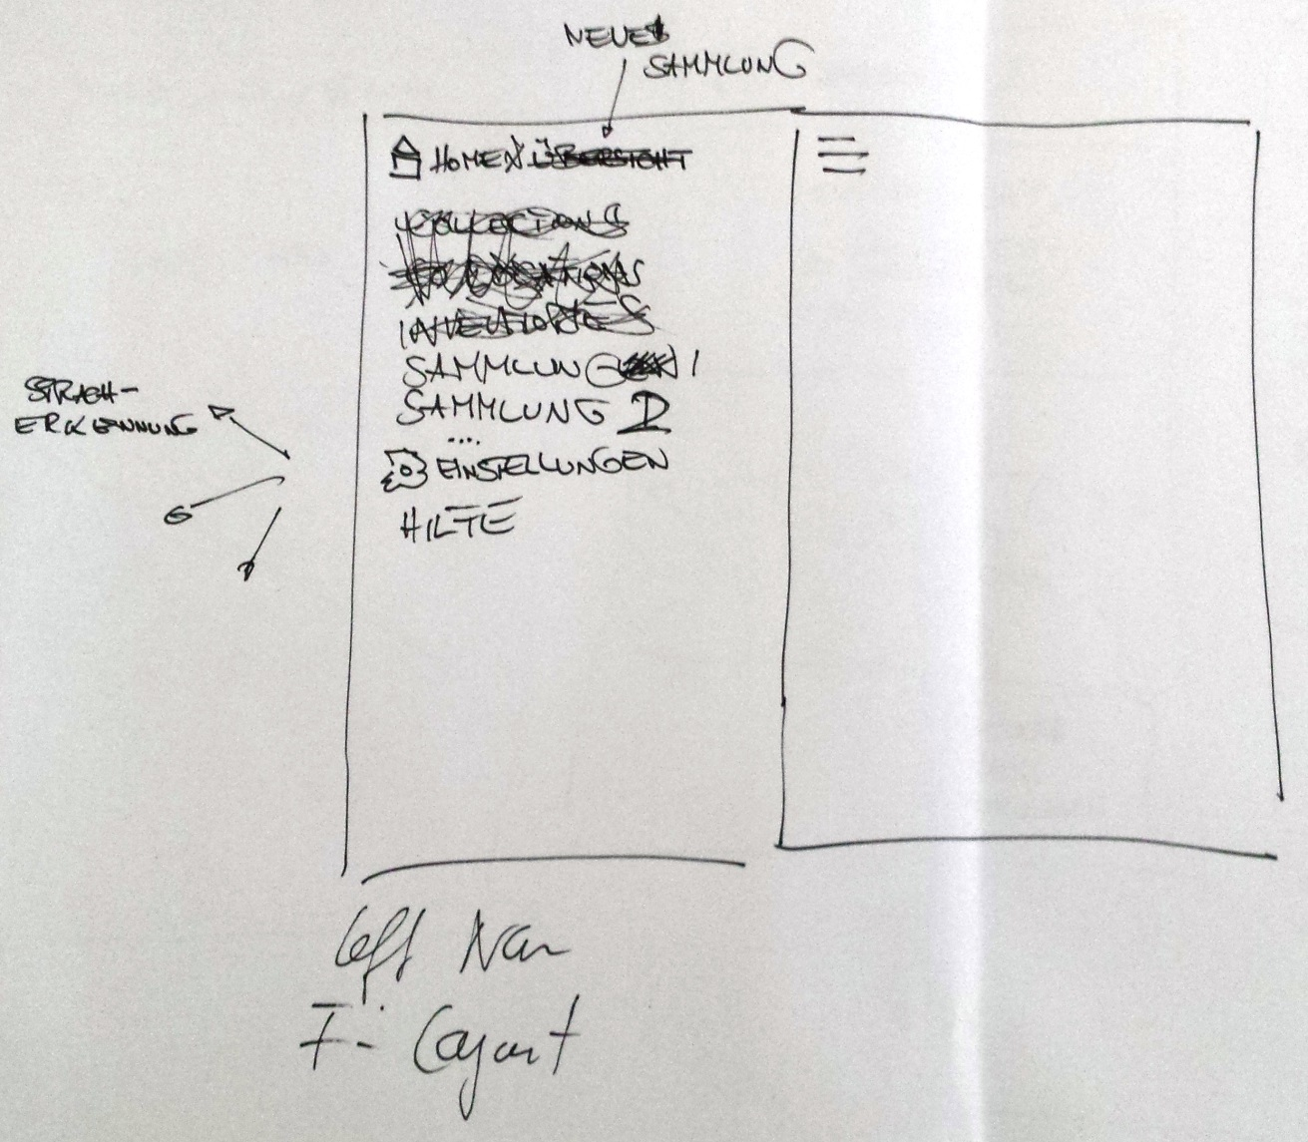
03-Navigation

Slide 5
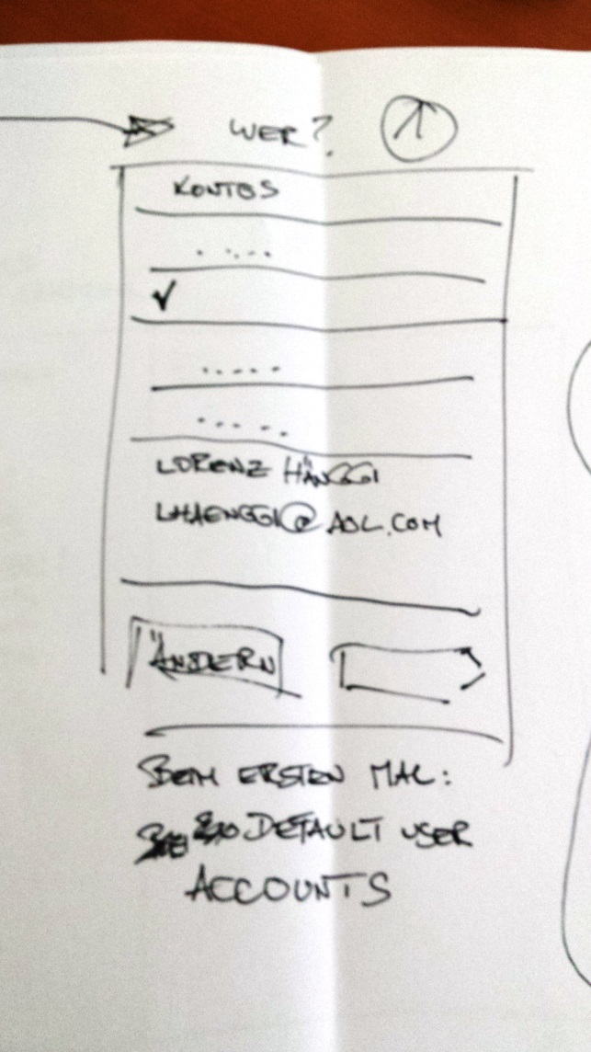
10-Inventory-New-Wer?

Slide 6
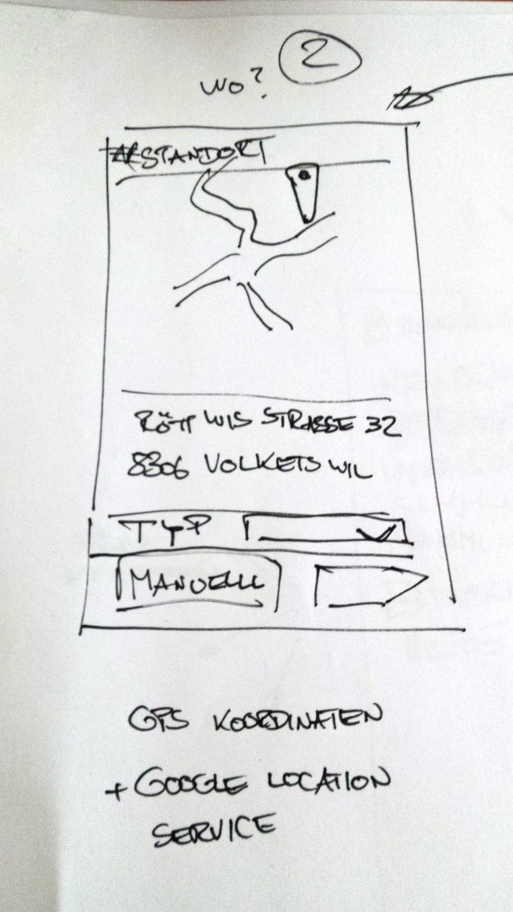
10-Inventory-New-Wo?

Slide 7
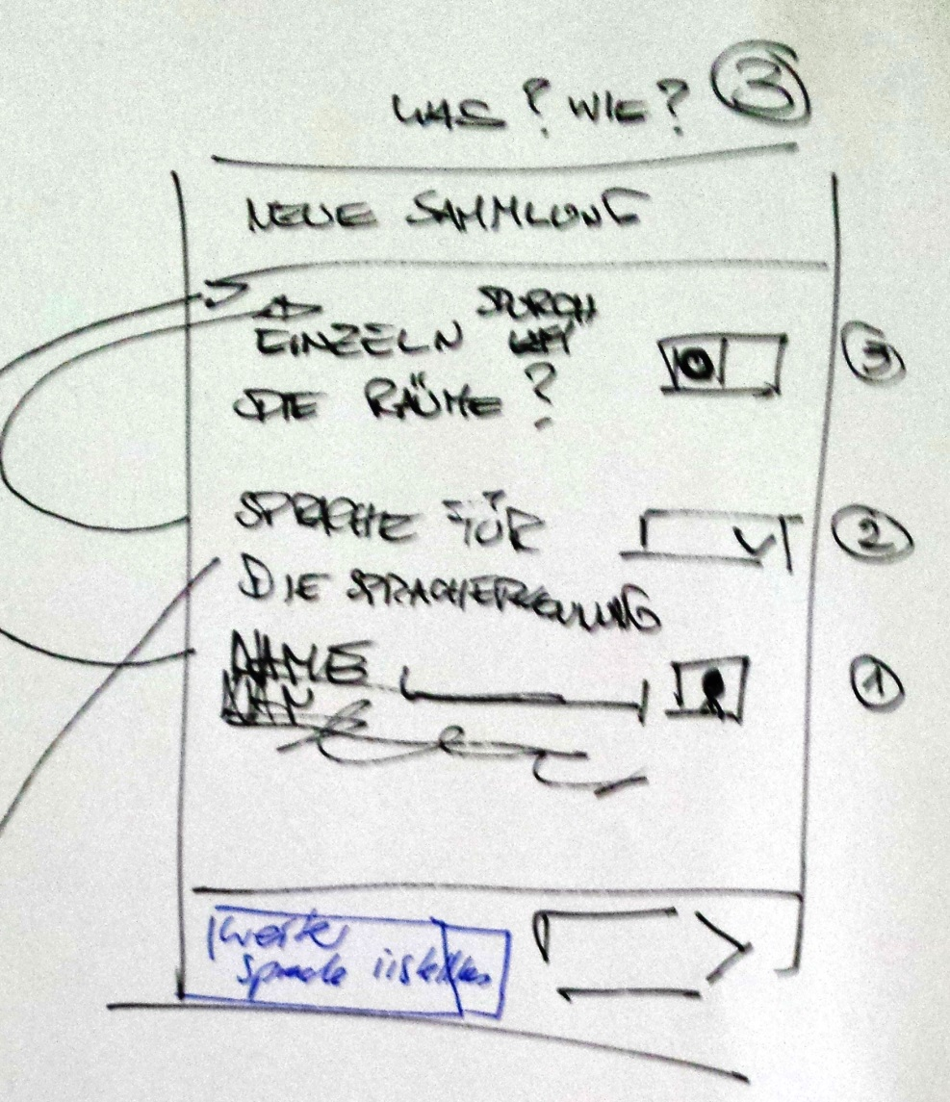
10-Inventory-New-Wie?Was?

Slide 8
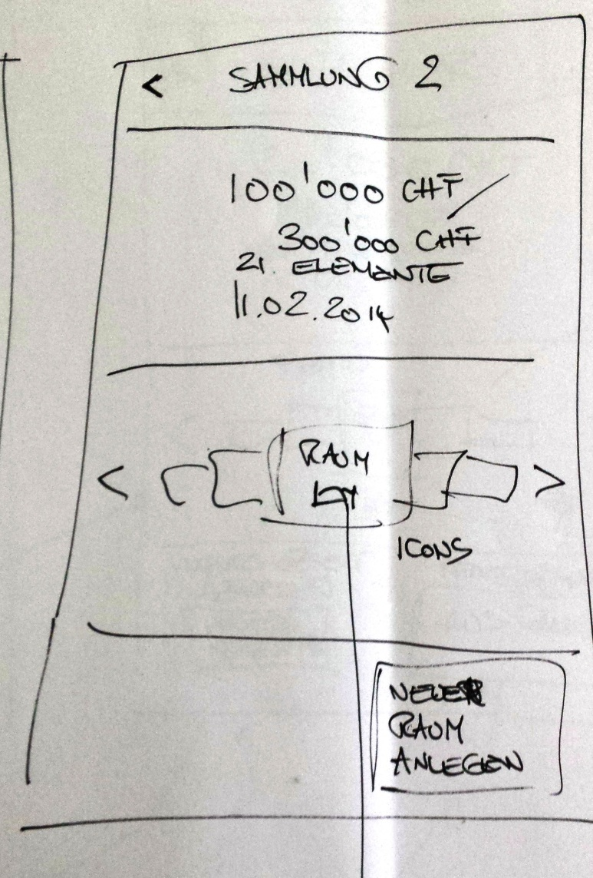
20-Inventar-Home
…

Slide 9
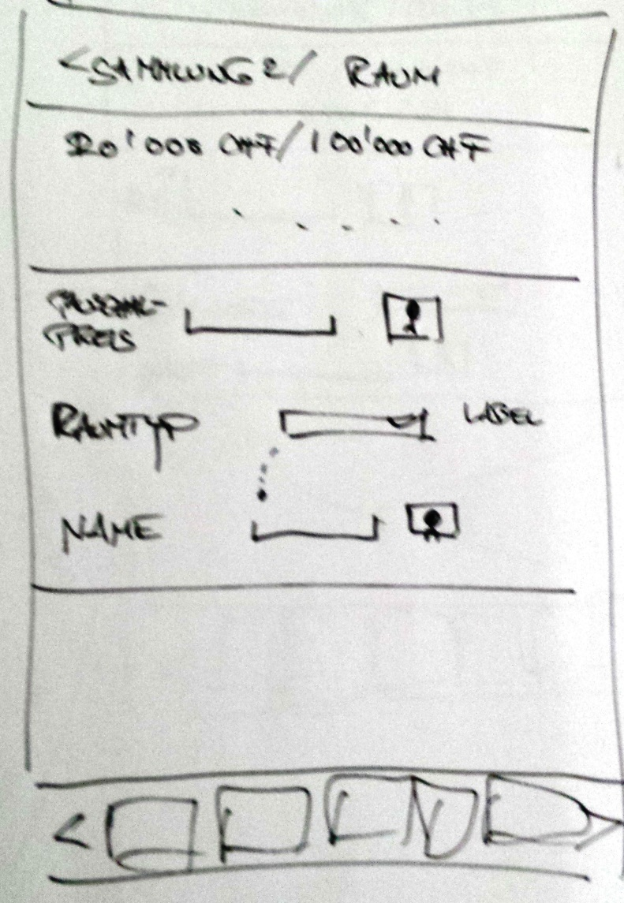


21-Room-NewEdit

Slide 10
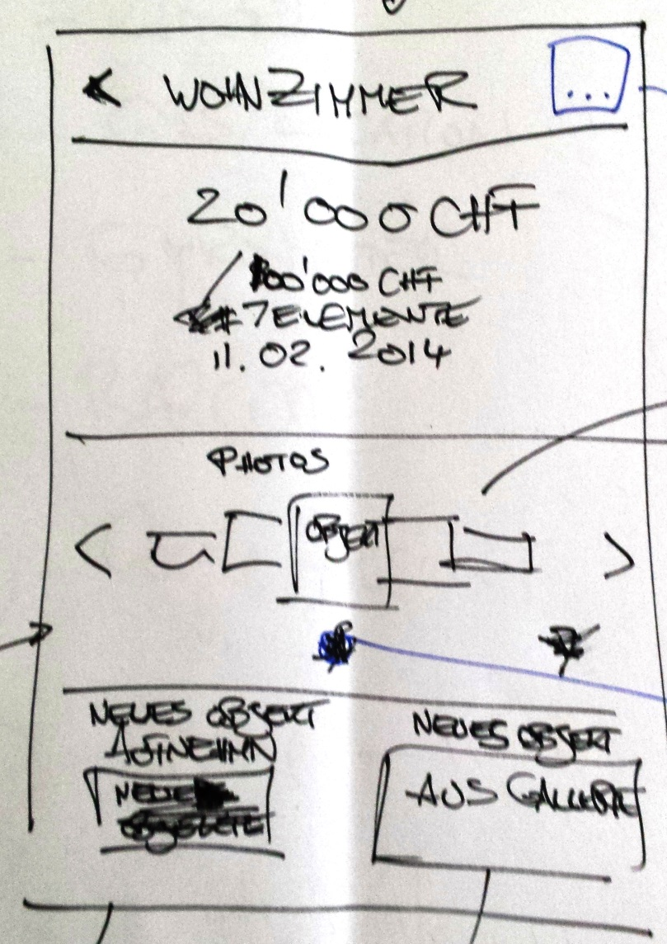

30-Room-Home

Slide 11
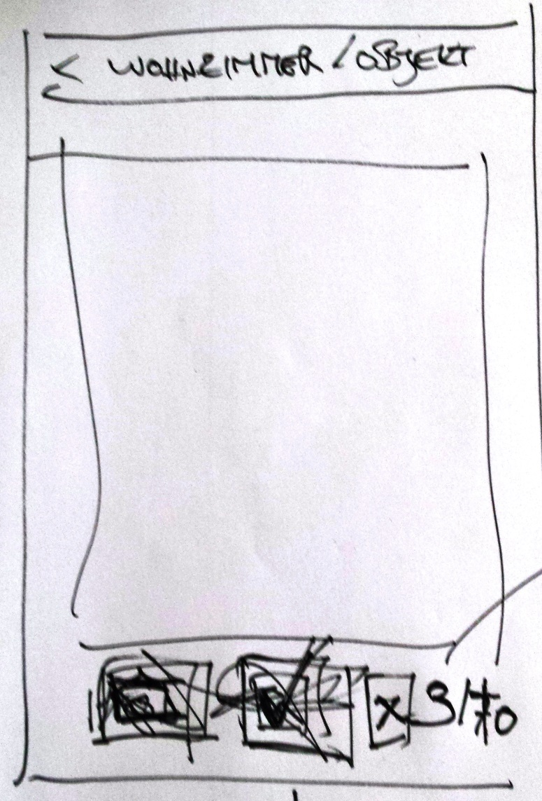
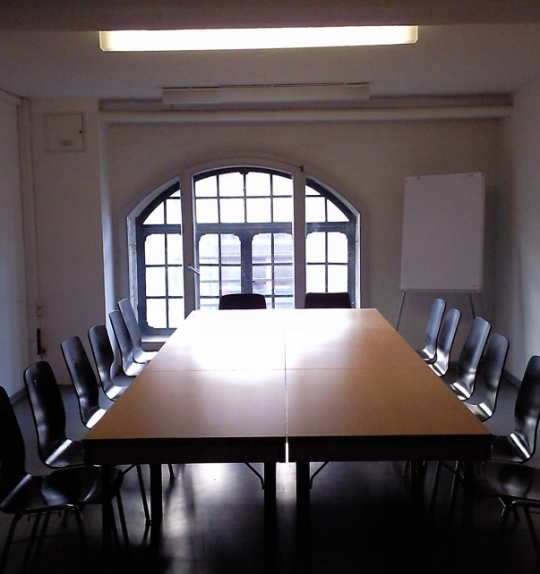


40-Room-CaptureImages

Slide 12
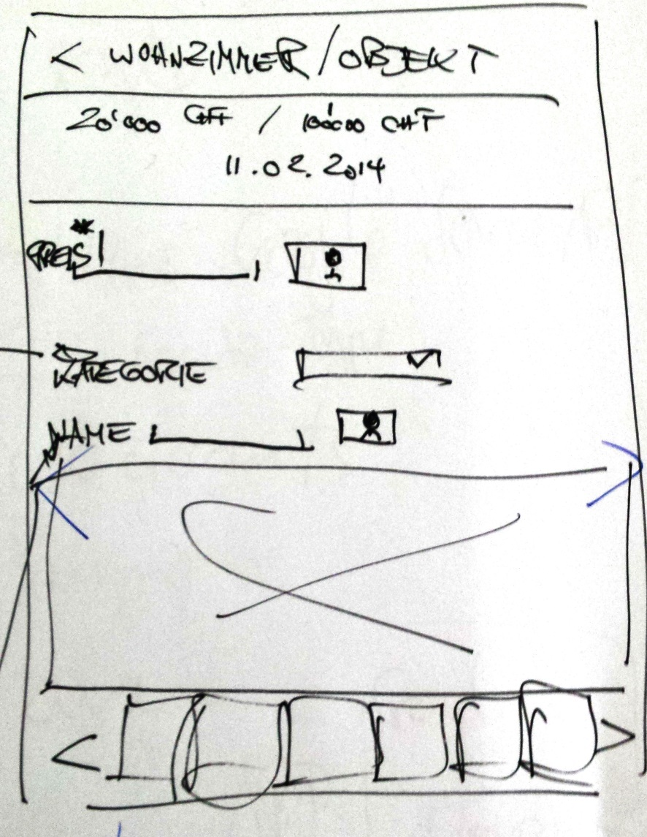

40-Objekt-Edit
Fertig

Slide 14
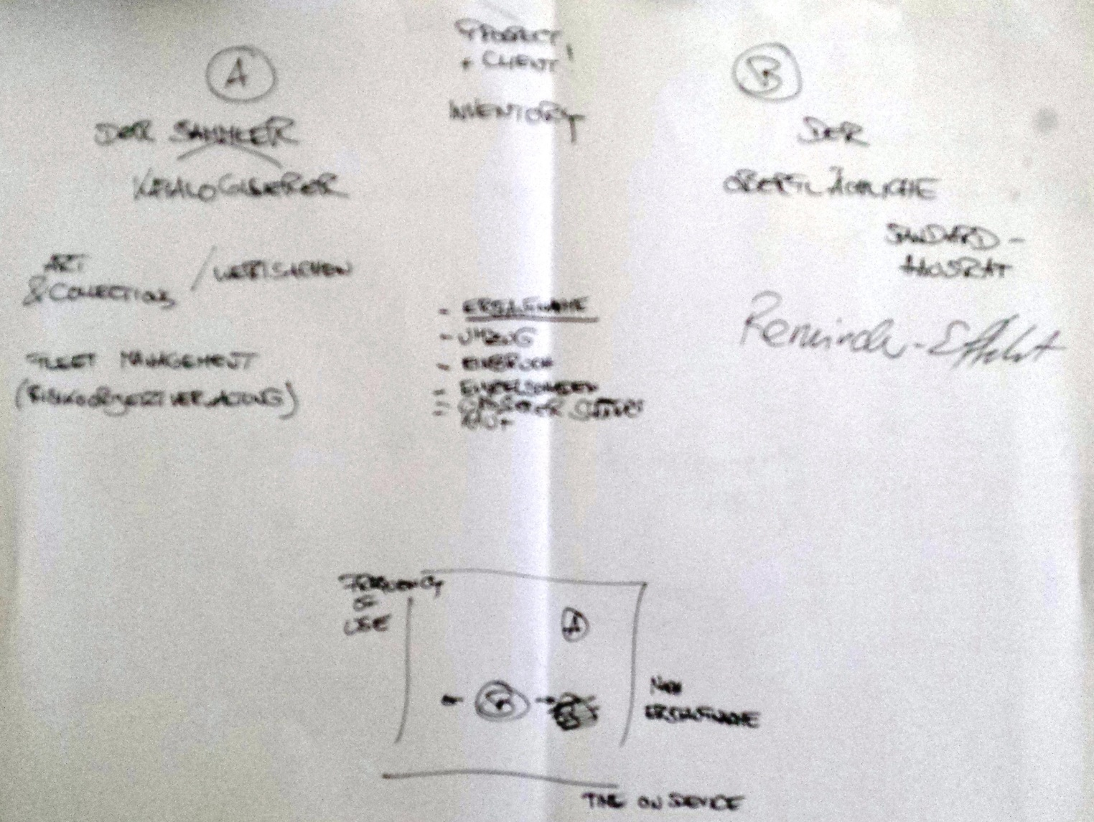
Benutzertypen

Slide 15
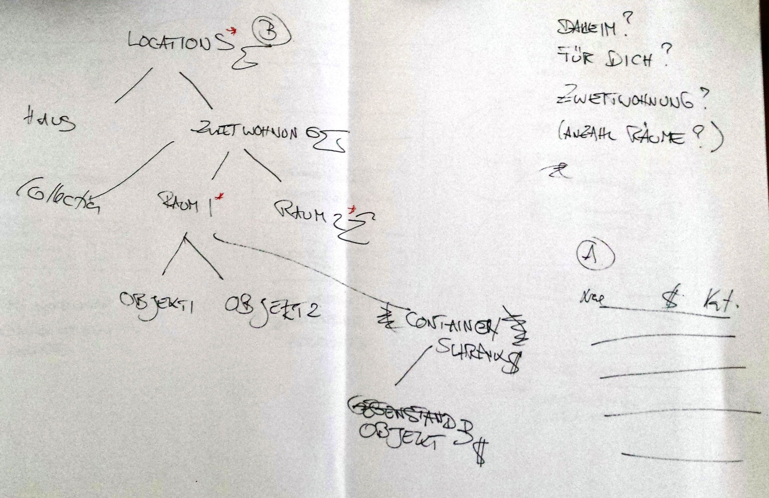
Struktur der Inventare

Slide 16
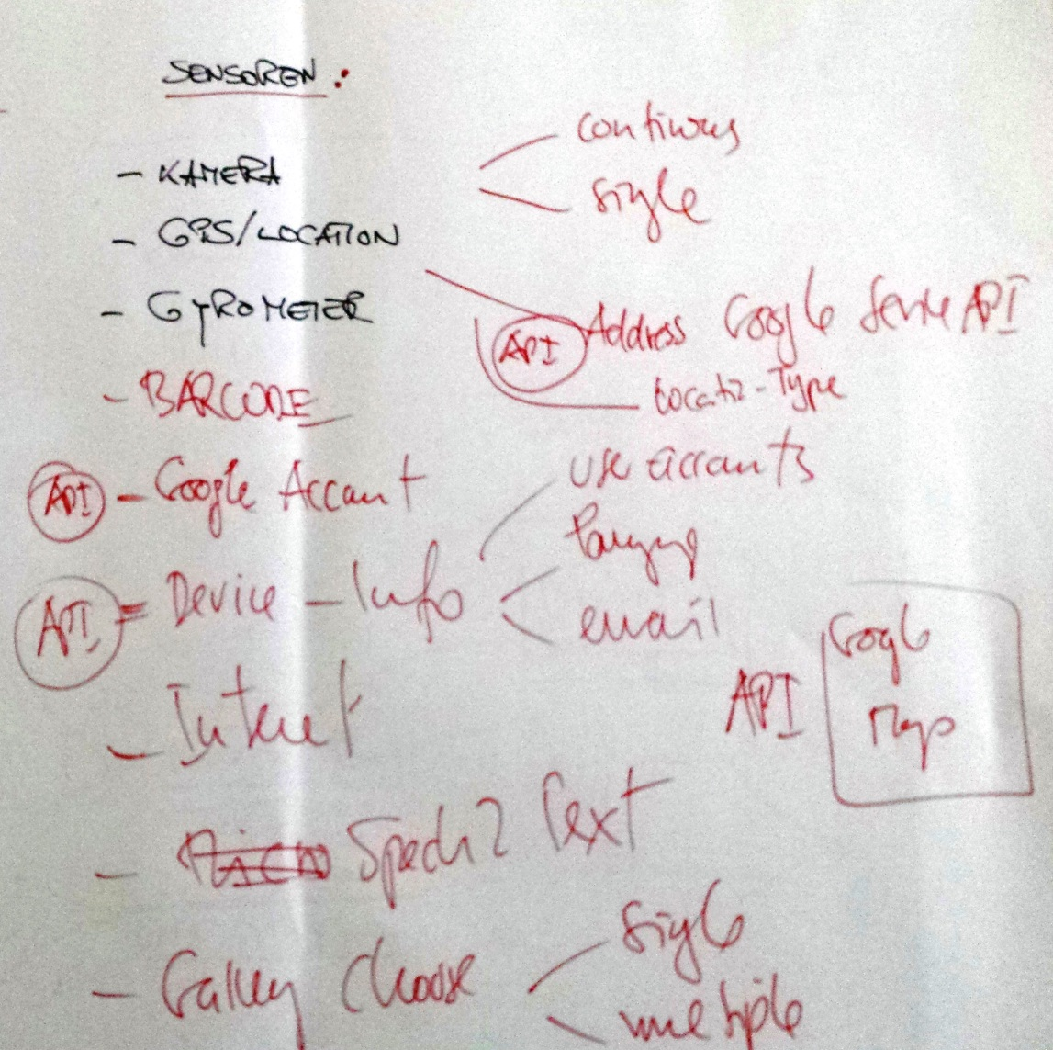

Slide 17
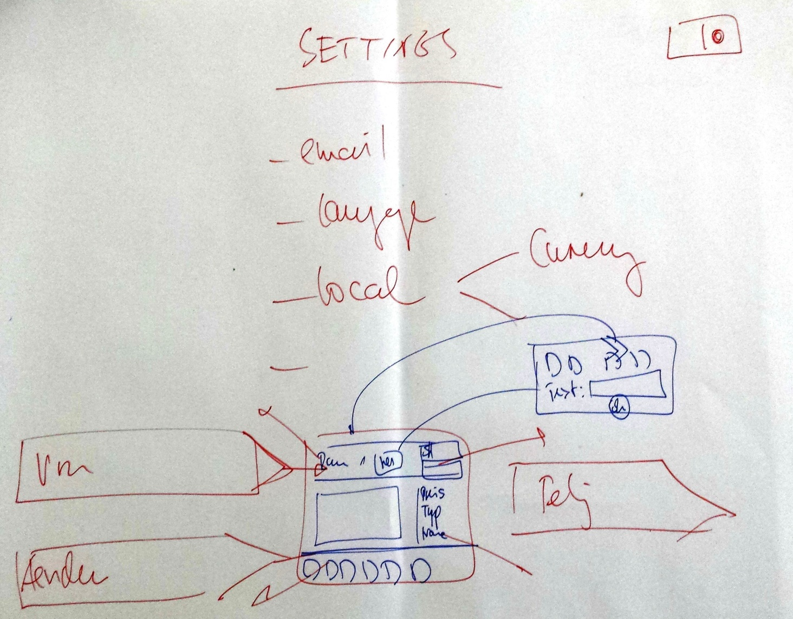
99-Settings

Slide 18


